Slide 1
Lecture 9
Storage and File Structure

Slide 2
Outline
Overview of Physical Storage Media
Magnetic Disks
RAID
Tertiary Storage
Storage Access
File Organization
Organization of Records in Files
Data-Dictionary Storage
Storage Structure of Oracle

Slide 3
Classification of Physical Storage Media
Speed with which data can be accessed
Cost per unit of data
Reliability
  data loss on power failure or system crash
  physical failure of the storage device
Can differentiate storage into:
  volatile storage: loses contents when power is switched off
  non-volatile storage:
    Contents persist even when power is switched off.
    Includes secondary and tertiary storage, as well as batter-backed up main-memory.

Slide 4
Physical Storage Media
Cache – fastest and most costly form of storage; volatile; managed by the computer system hardware.
Main memory:
  fast access (tens to hundreds of nanoseconds)
  generally too small (or too expensive) to store the entire database
    capacities of up to a few Gigabytes widely used currently
    Capacities have gone up and per-byte costs have decreased steadily and rapidly (roughly factor of 2 every 2 to 3 years)
  Volatile — contents of main memory are usually lost if a power failure or system crash occurs.

Slide 5
Physical Storage Media (Cont.)
Flash memory
  Data survives power failure
  Data can be written at a location only once, but location can be erased and written to again
    Can support only a limited number (10K – 1M) of write/erase cycles.
    Erasing of memory has to be done to an entire bank of memory
  Reads are roughly as fast as main memory
  But writes are slow (few microseconds), erase is slower
  Cost per unit of storage roughly similar to main memory
  Is a type of EEPROM
    Widely used in embedded devices, e.g. digital cameras

Slide 6
Physical Storage Media (Cont.)
Magnetic-disk
  Data is stored on spinning disk, and read/written magnetically
  Primary medium for the long-term storage of data
  Data must be moved from disk to main memory for access, and written back for storage
    Much slower access than main memory
  Direct-access
  Large capacity
    Lower cost per byte than main memory/flash memory
    Growing constantly and rapidly with technology improvements (factor of 2 to 3 every 2 years)
  Survives power failures and system crashes
    disk failure can destroy data, but is rare

Slide 7
Physical Storage Media (Cont.)
Optical storage
  non-volatile, data is read optically from a spinning disk using a laser
  CD-ROM (650 MB to 800 MB) and DVD (4.7 to 17 GB)
  Write-one, read-many (WORM) optical disks used for archival storage (CD-R, DVD-R, DVD+R)
  Rewritable disks supporting multiple write (CD-RW, DVD-RW, DVD+RW, and DVD-RAM)
  Reads and writes are slower than with magnetic disk
  A number of optical disks storing large volumes of data
    Juke-box systems, with large numbers of removable disks, a few drives, and a mechanism for automatic loading/unloading of disks
    Digital library

Slide 8
Optical Disks
CD-ROM: Compact disk - read only memory
  Removable disks, 640 MB per disk
  Seek time about 100 ms (optical read head is heavier and slower)
  Higher latency (3000 RPM) and lower data-transfer rates (3-6 MB/s) compared to magnetic disks
DVD: Digital Video Disk
  DVD-5 holds 4.7 GB , and DVD-9 holds 8.5 GB
  DVD-10 and DVD-18 are double sided formats with capacities of 9.4 GB and 17 GB
  Slow seek time, for same reasons as CD-ROM
CD-R and DVD-R: CD/DVD Record once versions
  data can only be written once, and cannot be erased.
  high capacity and long lifetime; used for archival storage
CD-RW, DVD-RW, DVD+RW and DVD-RAM: Multi-write versions

Slide 9
Physical Storage Media (Cont.)
Tape storage
  non-volatile, used primarily for backup (to recover from disk failure), and for archival data
  sequential-access – much slower than disk
  very high capacity (40 to 300 GB tapes available)
  tape can be removed from drive
    storage costs much cheaper than disk, but drives are expensive
  Tape jukeboxes available for storing massive amounts of data
    hundreds of terabytes (1 terabyte = 10⁹ bytes) to even a petabyte (1 petabyte = 10¹² bytes)

Slide 10
Magnetic Tapes
Hold large volumes of data and provide high transfer rates
  Few GB for DAT (Digital Audio Tape) format, 10-40 GB with DLT (Digital Linear Tape) format, 100 GB+ with Ultrium format, and 330 GB with Ampex helical scan format
  Transfer rates from few to 10s of MB/s
Currently the cheapest storage medium
  Tapes are cheap, but cost of drives is very high
Very slow access time in comparison to magnetic disks and optical disks
  limited to sequential access.
  Some formats (Accelis) provide faster seek (10s of seconds) at cost of lower capacity
Used mainly for backup, for storage of infrequently used information, and as an off-line medium for transferring information from one system to another.

Slide 11
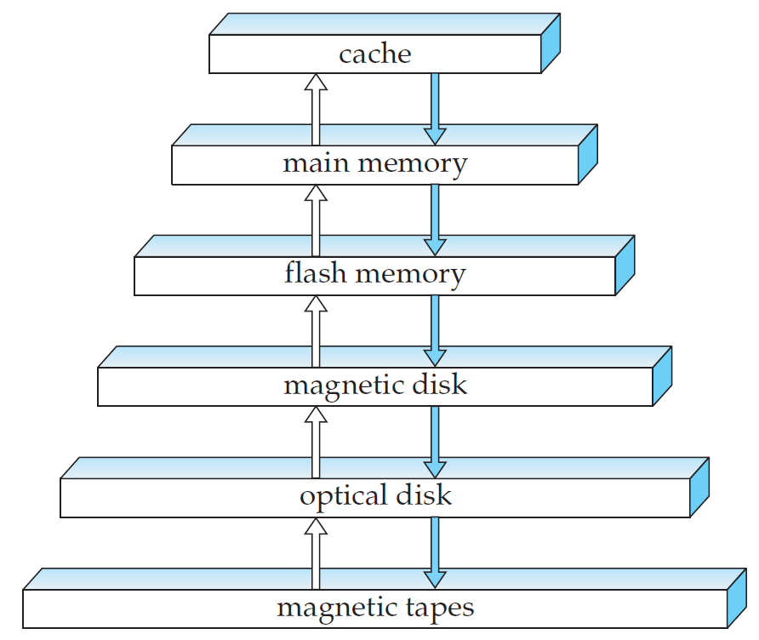
Storage Hierarchy

Slide 12
Storage Hierarchy (Cont.)
primary storage: Fastest media but volatile (cache, main memory).
secondary storage: next level in hierarchy, non-volatile, moderately fast access time
  also called on-line storage
  E.g. flash memory, magnetic disks
tertiary storage: lowest level in hierarchy, non-volatile, slow access time
  also called off-line storage
  E.g. magnetic tape, optical storage

Slide 13
Magnetic Disks
Read-write head
  Positioned very close to the platter surface (almost touching it)
  Reads or writes magnetically encoded information.
Tracks: surface of platter divided into circular tracks
  Over 50K-100K tracks per platter on typical hard disks
Sectors: each track is divided into sectors.
  A sector is the smallest unit of data that can be read or written.
  Sector size typically 512 bytes
  Typical sectors per track: 500 (on inner tracks) to 1000 (on outer tracks)

Slide 14
Magnetic Disks (cont.)
To read/write a sector
  disk arm swings to position head on right track
  platter spins continually; data is read/written as sector passes under head
Cylinder i consists of i^{th} track of all the platters
Head-disk assemblies
  multiple disk platters on a single spindle (1 to 5 usually)
  one head per platter, mounted on a common arm.

Slide 15
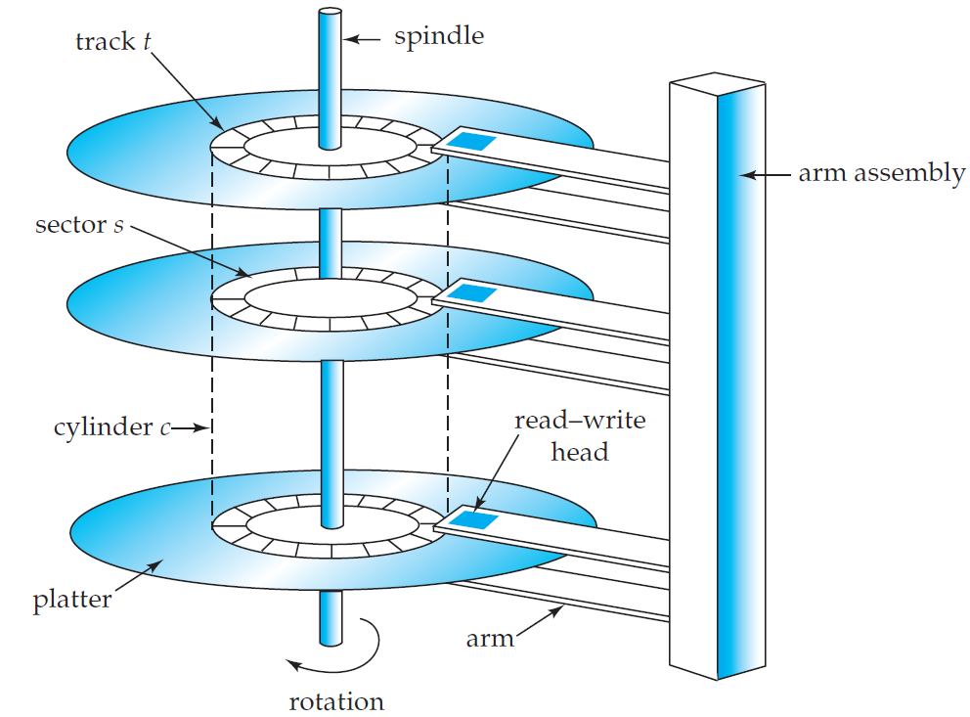
Magnetic Hard Disk Mechanism
NOTE: Diagram is schematic, and simplifies the structure of actual disk drives

Slide 16
Magnetic Disks (cont.)
Earlier generation disks were susceptible to head-crashes
  Surface of earlier generation disks had metal-oxide coatings which would disintegrate on head crash and damage all data on disk
  Current generation disks are less susceptible to such disastrous failures, although individual sectors may get corrupted
  Shockproof technique

Slide 17
Disk Subsystem
Disk controller – interfaces between the computer system and the disk drive hardware.
  accepts high-level commands to read or write a sector
  initiates actions such as moving the disk arm to the right track and actually reading or writing the data
  Computes and attaches checksums to each sector to verify that data is read back correctly
    If data is corrupted, with very high probability stored checksum won’t match recomputed checksum
  Ensures successful writing by reading back sector after writing it
  Performs remapping of bad sectors

Slide 18
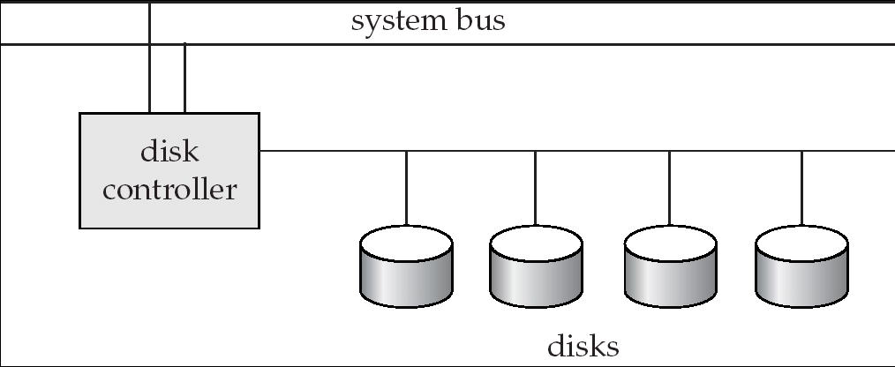
Disk Subsystem
Multiple disks connected to a computer system through a controller
  Controllers functionality (checksum, bad sector remapping) often carried out by individual disks; reduces load on controller
Disk interface standards families
  ATA (AT adaptor) range of standards
  SATA (Serial ATA)
  SCSI (Small Computer System Interconnect) range of standards
  Several variants of each standard (different speeds and capabilities)

Slide 19
Performance Measures of Disks
Access time – the time it takes from when a read or write request is issued to when data transfer begins. Consists of:
  Seek time – time it takes to reposition the arm over the correct track.
    Average seek time is 1/2 the worst case seek time.
      Would be 1/3 if all tracks had the same number of sectors, and we ignore the time to start and stop arm movement
    4 to 10 milliseconds on typical disks
  Rotational latency – time it takes for the sector to be accessed to appear under the head.
    Average latency is 1/2 of the worst case latency.
    4 to 11 milliseconds on typical disks (5400 to 15000 r.p.m.)

Slide 20
Performance Measures of Disks (cont.)
Data-transfer rate – the rate at which data can be retrieved from or stored to the disk.
  25 to 100 MB per second max rate, lower for inner tracks
  Multiple disks may share a controller, so rate that controller can handle is also important
    E.g. ATA-5: 66 MB/sec, SATA II: 300 MB/sec, Ultra 320 SCSI: 320 MB/s, SAS: 3Gbps
    Fiber Channel (FC2Gb): 256 MB/s

Slide 21
Performance Measures of Disks (cont.)
Mean time to failure (MTTF) – the average time the disk is expected to run continuously without any failure.
  Typically 3 to 5 years
  Probability of failure of new disks is quite low, corresponding to a “theoretical MTTF” of 500,000 to 1,200,000 hours (even more!) for a new disk
    But when more disks are considered, things become different.
    E.g., an MTTF of 1,200,000 hours for a new disk means that given 1000 relatively new disks, on an average one will fail every 1200 hours (50 days)
  MTTF decreases as disk ages

Slide 22
Optimization of Disk-Block Access
Block – a contiguous sequence of sectors from a single track
  data is transferred between disk and main memory in blocks
  sizes range from 512 bytes to several kilobytes
    Smaller blocks: more transfers from disk
    Larger blocks: more space wasted due to partially filled blocks
    Typical block sizes today range from 4 to 16 kilobytes

Slide 23
Optimization of Disk-Block Access (cont.)
Disk-arm-scheduling algorithms order pending accesses to tracks so that disk arm movement is minimized
  elevator algorithm
    move disk arm in one direction (from outer to inner tracks or vice versa)
    processing next request in that direction, till no more requests in that direction
    then reverse direction and repeat

Slide 24
Optimization of Disk-Block Access (cont.)
File organization – optimize block access time by organizing the blocks to correspond to how data will be accessed
  E.g. Store related information on the same or nearby cylinders.
  Files may get fragmented over time
    E.g. if data is inserted to/deleted from the file
    Or free blocks on disk are scattered, and newly created file has its blocks scattered over the disk
    Sequential access to a fragmented file results in increased disk arm movement
  Some systems have utilities to defragment the file system, in order to speed up file access

Slide 25
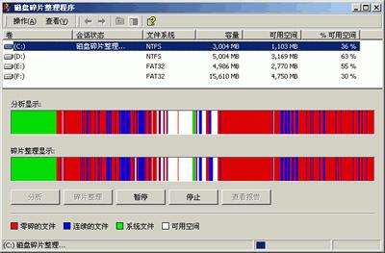
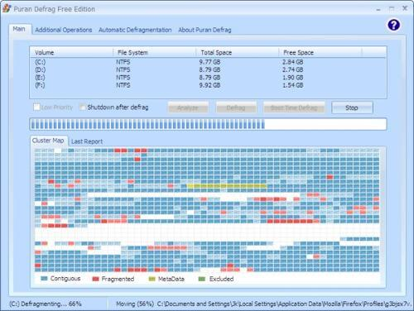
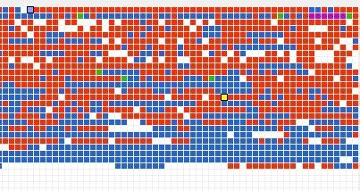

Slide 26
Optimization of Disk Block Access (cont.)
Nonvolatile write buffers speed up disk writes by writing blocks to a non-volatile RAM buffer immediately
  Non-volatile RAM: battery backed up RAM or flash memory
  Controller then writes to disk whenever the disk has no other requests or request has been pending for some time
  Database operations that require data to be safely stored before continuing can continue without waiting for data to be written to disk
  Writes can be reordered to minimize disk arm movement

Slide 27
Optimization of Disk Block Access (cont.)
Log disk – a disk devoted to writing a sequential log of block updates
  Used exactly like nonvolatile RAM
    Write to log disk is very fast since no seeks are required
    No need for special hardware (NV-RAM)
File systems typically reorder writes to disk to improve performance
  Journaling file systems write data in safe order to NV-RAM or log disk
  Reordering without journaling: risk of corruption of file system data

Slide 28
RAID
RAID: Redundant Arrays of Independent Disks
  disk organization techniques that manage a large numbers of disks, providing a view of a single disk of
    high capacity and high speed by using multiple disks in parallel, and
    high reliability by storing data redundantly, so that data can be recovered even if a disk fails

Slide 29
RAID
The chance that some disk out of a set of N disks will fail is much higher than the chance that a specific single disk will fail.
  E.g., a system with 100 disks, each with MTTF of 100,000 hours (11+ years), will have a system MTTF of 1000 hours (42- days)
  Techniques for using redundancy to avoid data loss are critical with large numbers of disks
Originally a cost-effective alternative to large, expensive disks
  “I” in RAID originally stood for “ inexpensive ”
  Today RAIDs are used for their higher reliability and bandwidth.
    The “I” is interpreted as “ independent ”

Slide 30
Improvement of Reliability via Redundancy
Redundancy
  store extra information that can be used to rebuild information lost in a disk failure
e.g. Mirroring (or shadowing)
  Duplicate every disk. Logical disk consists of two physical disks.
  Every write is carried out on both disks
  Reads can take place from either disk
  If one disk in a pair fails, data still available in the other
    Data loss would occur only if a disk fails, and its mirror disk also fails before the system is repaired
      Probability of combined event is very small

Slide 31
Improvement of Reliability via Redundancy (cont.)
Mean time to data loss depends on mean time to failure, and mean time to repair
  e.g. MTTF of 100,000 hours, mean time to repair of 10 hours gives mean time to data loss of 500*10⁶ hours (or 57,000 years) for a mirrored pair of disks (ignoring dependent failure modes)

Slide 32
Improvement in Performance via Parallelism
Two main goals of parallelism in a disk system:
  1. Load balance multiple small accesses to increase throughput
  2. Parallelize large accesses to reduce response time.
Improve transfer rate by striping data across multiple disks.
  A request for a long sequence of blocks can utilize all disks in parallel

Slide 33
Improvement in Performance via Parallelism (cont.)
Bit-level striping – split the bits of each byte across multiple disks
  In an array of eight disks, write bit i of each byte to disk i.
  Each access can read data at eight times the rate of a single disk.
  But seek/access time worse than for a single disk
    Bit level striping is not used much any more
Block-level striping – with n disks, block i of a file goes to disk (i mod n) + 1
  Requests for different blocks can run in parallel if the blocks reside on different disks

Slide 34

RAID Levels
Schemes to provide redundancy at lower cost by using disk striping combined with parity bits.
RAID Level 0: Block striping; non-redundant.
  Used in high-performance applications where data lose is not critical.
RAID Level 1: Mirrored disks with block striping
  Usually known as 1+0
  Offers best write performance.
  Popular for applications such as storing log files in a database system.

Slide 35
RAID Levels (Cont.)
RAID Level 2: Memory-Style Error-Correcting-Codes (ECC) with bit striping.
RAID Level 3: Bit-Interleaved Parity
  a single parity bit is enough for error correction, not just detection, since we know which disk has failed
    When writing data, corresponding parity bits must also be computed and written to a parity bit disk
    To recover data in a damaged disk, compute XOR of bits from other disks (including parity bit disk)

Slide 36
RAID Levels (Cont.)
RAID Level 3 (cont.)
  Faster data transfer than with a single disk, but fewer I/Os per second since every disk has to participate in every I/O.
  Subsumes Level 2 (provides all its benefits, at lower cost).
RAID Level 4: Block-Interleaved Parity; uses block-level striping, and keeps a parity block on a separate disk for corresponding blocks from N other disks.
  When writing data block, corresponding block of parity bits must also be computed and written to parity disk
  To find value of a damaged block, compute XOR of bits from corresponding blocks (including parity block) from other disks.

Slide 37
RAID Levels (Cont.)
RAID Level 4 (Cont.)
  Provides higher I/O rates for independent block reads than Level 3
    block read goes to a single disk, so blocks stored on different disks can be read in parallel
  Provides high transfer rates for reads of multiple blocks than no-striping
  Before writing a block, parity data must be computed
    Can be done by using old parity block, old value of current block and new value of current block (2 block reads + 2 block writes)
    Or by recomputing the parity value using the new values of blocks corresponding to the parity block
      More efficient for writing large amounts of data sequentially
  Parity block becomes a bottleneck for independent block writes since every block write also writes to parity disk

Slide 38
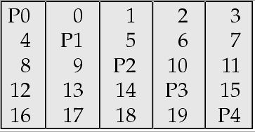
RAID Levels (Cont.)
RAID Level 5: Block-Interleaved Distributed Parity; partitions data and parity among all N + 1 disks, rather than storing data in N disks and parity in 1 disk.
  e.g., with 5 disks, parity block for nth set of blocks is stored on disk (n mod 5) + 1, with the data blocks stored on the other 4 disks.

Slide 39
RAID Levels (Cont.)
RAID Level 5 (Cont.)
  Higher I/O rates than Level 4.
    Block writes occur in parallel if the blocks and their parity blocks are on different disks.
  Subsumes Level 4: provides same benefits, but avoids bottleneck of parity disk.
RAID Level 6: P+Q Redundancy scheme; similar to Level 5, but stores extra redundant information to guard against multiple disk failures.
  Better reliability than Level 5 at a higher cost; not used as widely.

Slide 40
Choice of RAID Level
Factors in choosing RAID level
  Monetary cost
  Performance requirements
    In terms of number of I/O operations
  Performance during failure
  Performance during rebuild of failed disk
    Including time taken to rebuild failed disk

Slide 41
Choice of RAID Level (cont.)
Comparison between RAID levels
  RAID 0 is used only when data safety is not critical
    e.g., data can be recovered quickly from other sources
  Level 2 and 4 never used since they are subsumed by 3 and 5
  Level 3 is not used anymore since bit-striping forces single block reads to access all disks, wasting disk arm movement, which block striping (level 5) avoids
  Level 6 is rarely used
    Rarely supported by RAID implementations
    Levels 1 and 5 offer adequate safety for almost all applications
  So competition is between 1 (1+0) and 5 only

Slide 42
Choice of RAID Level (cont.)
Level 1 provides much better write performance than Level 5
  Level 5 requires at least 2 block reads and 2 block writes to write a single block, whereas Level 1 only requires 2 block writes
  Level 1 preferred for high update environments such as log disks
Level 1 has higher storage cost than Level 5
  disk drive capacities increasing rapidly (50%/year) whereas disk access times have decreased much less (x 3 in 10 years)
  I/O requirements have increased greatly, e.g. for Web servers
  When enough disks have been bought to satisfy required rate of I/O, they often have spare storage capacity
    so there is often no extra monetary cost for Level 1!

Slide 43
Choice of RAID Level (cont.)
Choice between RAID 1 and RAID 5
  Level 5 is preferred for applications with low update rate,
  and large amounts of data
  Level 1 is preferred for less requirements for space efficiency

Slide 44
Hardware Issues
Software RAID: RAID implementations done entirely in software, with no special hardware support
Hardware RAID: RAID implementations with special hardware
  Use non-volatile RAM to record writes that are being executed
  Beware: power failure during write can result in corrupted disk
    E.g. failure after writing one block but before writing the second in a mirrored system
    Such corrupted data must be detected when power is restored
      Recovery from corruption is similar to recovery from failed disk
      NV-RAM helps to efficiently detect potentially corrupted blocks
        Otherwise all blocks of disk must be read and compared with mirror/parity block

Slide 45
Hardware Issues (Cont.)
Hot swapping: replacement of disk while system is running, without power down
  Supported by some hardware RAID systems,
  reduces time to recovery, and improves availability greatly
Many systems maintain spare disks which are kept online, and used as replacements for failed disks immediately on detection of failure
  Reduces time to recovery greatly
Many hardware RAID systems ensure that a single point of failure will not stop the functioning of the system by using
  Redundant power supplies with battery backup
  Multiple controllers and multiple interconnections to guard against controller/interconnection failures

Slide 46
Storage Access
A database file is partitioned into fixed-length storage units called blocks. Blocks are units of both storage allocation and data transfer.
Database system seeks to minimize the number of block transfers between the disk and memory. We can reduce the number of disk accesses by keeping as many blocks as possible in main memory.
Buffer – portion of main memory available to store copies of disk blocks.
Buffer manager – subsystem responsible for allocating buffer space in main memory.

Slide 47
Buffer Manager
Programs call on the buffer manager when they need a block from disk.
  If the block is already in the buffer, buffer manager returns the address of the block in main memory
  If the block is not in the buffer, the buffer manager
    Allocates space in the buffer for the block
      Replacing (throwing out) some other block, if required, to make space for the new block.
      Replaced block written back to disk only if it was modified since the most recent time that it was written to/fetched from the disk.
    Reads the block from the disk to the buffer, and returns the address of the block in main memory to requester.

Slide 48
Buffer-Replacement Policies
Most operating systems replace the block least recently used (LRU strategy)
Idea behind LRU – use past pattern of block references as a predictor of future references
Queries have well-defined access patterns (such as sequential scans), and a database system can use the information in a user’s query to predict future references
  LRU can be a bad strategy for certain access patterns involving repeated scans of data
    For example: when computing the join of 2 relations r and s by nested loops
  Mixed strategy with hints on replacement strategy provided by the query optimizer is preferable

Slide 49
Buffer-Replacement Policies (cont.)
Pinned block
  memory block that is not allowed to be written back to disk
Toss-immediate strategy
  frees the space occupied by a block as soon as the final tuple of that block has been processed
Most recently used (MRU) strategy
  system must pin the block currently being processed. After the final tuple of that block has been processed, the block is unpinned, and it becomes the most recently used block.
Buffer manager can use statistical information regarding the probability that a request will reference a particular relation
  e.g., data dictionary

Slide 50
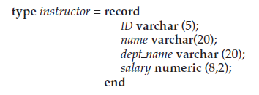
File Organization
The database is stored as a collection of files. Each file is a sequence of records. A record is a sequence of fields.
One approach:
  assume record size is fixed
  each file has records of one particular type only
  different files are used for different relations

Slide 51
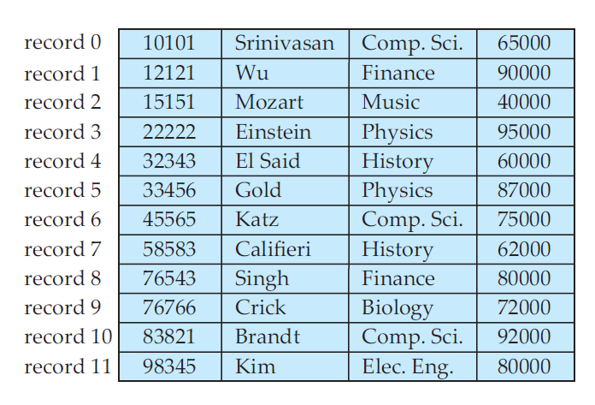
Fixed-Length Records
Simple approach:
  Store record i starting from byte n ∗ i, where n is the size of each record. ( i >= 0 )
  Record access is simple but records may cross blocks
    do not allow records to cross block boundaries

Slide 52
Fixed-Length Records
Simple approach:
  Store record i starting from byte n ∗ i, where n is the size of each record. ( i >= 0 )
  Deletion of record i:
    For example, deleting record 3…

Slide 53

Fixed-Length Records
Simple approach:
  Store record i starting from byte n ∗ i, where n is the size of each record. ( i >= 0 )
  Deletion of record i:
    More records i+1, … , n to i, … , n-1

Slide 54

Fixed-Length Records
Simple approach:
  Store record i starting from byte n ∗ i, where n is the size of each record. ( i >= 0 )
  Deletion of record i:
    More record n to i

Slide 55
Fixed-Length Records
Simple approach:
  Store record i starting from byte n ∗ i, where n is the size of each record. ( i >= 0 )
  Deletion of record i:
    Do not move records, but link all free records on a free list

Slide 56

Free Lists
Introduce a new structure to find available space

Slide 57
Free Lists
More space efficient representation: reuse space for normal attributes of free records to store pointers. (No pointers stored in in-use records.)

Slide 58
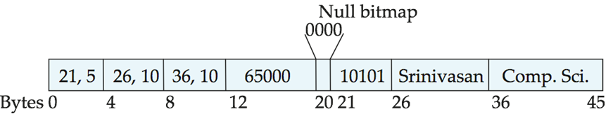
Variable-Length Records
Variable-length records arise in database systems in several ways:
  Storage of multiple record types in a file.
  Record types that allow variable lengths for one or more fields.
  Record types that allow repeating fields (used in some older data models).
Attributes are stored in order
Variable length attributes represented by fixed size (offset, length), with actual data stored after all fixed length attributes
Null values represented by null-value bitmap

Slide 59

Variable-Length Records: Slotted Page Structure
Slotted page header contains:
  number of record entries
  end of free space in the block
  location and size of each record
Pointers should not point directly to record — instead they should point to the entry for the record in header.

Slide 60
Organization of Records in Files
Heap – a record can be placed anywhere in the file where there is space
Sequential – store records in sequential order, based on the value of the search key of each record
Hashing – a hash function computed on some attribute of each record; the result specifies in which block of the file the record should be placed
Records of each relation may be stored in a separate file.
  Multitable clustering file organization: records of several different relations can be stored in the same file.
  Motivation: store related records on the same block to minimize I/O

Slide 61

Sequential File Organization
Suitable for applications that require sequential processing of the entire file
The records in the file are ordered by a search-key

Slide 62

Sequential File Organization (cont.)
Deletion – use pointers in the pointer chain
Insertion –locate the position where the record is to be inserted
  if there is free space insert there
  if no free space, insert the record in an overflow block
  Pointer chain must be updated
Need to reorganize
the file from time to
time to restore
sequential order

Slide 63



Multitable Clustering File Organization
Store several relations in one file using a multitable clustering file organization
department
instructor
multitable clustering
of department and
instructor

Slide 64

Multitable Clustering File Organization (cont.)
  Good for queries involving depositor customer, and for queries involving one single customer and his accounts
  Bad for queries involving only customer
  Results in variable size records
  Can add pointer chains to link records of a particular relation

Slide 65
Data Dictionary Storage
Data dictionary (also called system catalog) stores metadata; that is, data about data, such as:
Information about relations
  names of relations
  names, types and lengths of attributes of each relation
  names and definitions of views
  integrity constraints
Information about indices
User and accounting information, including passwords
Statistical and descriptive data
  number of tuples in each relation
Physical file organization information
  How relation is stored (sequential/hash/…)
  Physical location of relation

Slide 66

Data Dictionary Storage (cont.)
Relational representation on disk
specialized data structures designed for efficient access, in memory

Slide 67
Storage Structure of Oracle
Logical structure: internal manner of data organizing and managing in Oracle
Physical structure: external manner of data organizing and managing in OS
Oracle logical storage structure is independent of the physical structure

Slide 68
Logical Storage Structure
Block
  The basic unit that Oracle access storage space. Oracle reads or writes at least 1 block when performing every I/O request
  An Oracle block is made up of one or more OS blocks. OS block is the smallest unit that OS interaction with hard disk
  The size of Oracle block is defined by the DB_BLOCK_SIZE parameter, usually 4096 bytes

Slide 69
Logical Storage Structure (Cont.)
Block (cont.)
  Block Head: contains normal information about the block, such as physical address, segment type (data seg, index seg, etc. )
  Table Catalog: contains information about a specific table if the block is used to store data for that table
  Row Catalog: contains information about the rows if the block is used to store data of a table, such as ROWID
  Free Space: space that is not used
  Row Space: space that is used
Block Head
Table Catalog
Row Catalog
Free Space
Row Space

Slide 70
Logical Storage Structure (Cont.)
Extent
  A higher level structure than block
  An extent is made up of a series of continuous blocks
  When Oracle allocates space for a table, it will allocate many continuous blocks every time. So the extent is the basic unit that Oracle allocates, unallocates and manages the storage space
Segment
  A higher level structure than extent
  A segment is made up of several extents, may or may not be continuous
  When a user creates objects that have actual storage structure such as tables or indexes in database, Oracle will create segments for them. Normally, every object owns only one segment
Tablespace
  The highest level structure
  A database is made up of many tablespaces
  Segments and extents are contained in tablespaces
  Oracle puts the objects that relative logically to each other in a tablespace

Slide 71
Logical Storage Structure (Cont.)
Segment
112KB
Tablespace
Extent
28KB
Extent
84KB
Segment N
2KB
2KB
2KB
2KB
2KB
2KB
2KB
2KB
2KB
2KB
2KB
2KB
2KB
2KB
2KB
2KB
2KB
2KB
2KB
2KB
2KB
2KB
2KB
2KB
2KB
2KB
2KB
2KB
Database
2KB
2KB
2KB
2KB
Tablespace
2KB
2KB
2KB
2KB
2KB
2KB
2KB
2KB
2KB
2KB
2KB
2KB
2KB
2KB
2KB
2KB

Slide 72
Logical Storage Structure (Cont.)
Mostly used tablespaces in Oracle:
  SYSTEM: data dictionary
  UNDOTBS: used for rollback operations
  USERS: user objects
  TEMP: temporary space
  INDX: indexes
  use
  select tablespace_name from user_tablespaces;
  to observe your tablespaces.

Slide 73
Touching Oracle Storage Structures
Get to know how data is stored in blocks, how blocks make up of extents, how extents make up of segments, and how segments are contained in tablespaces
Also get information about fragment (extents, blocks)
  select substr(tablespace_name,1,5) "Tablespace Name", extent_id, block_id, blocks,
  substr(segment_name,1,16) "Segment Name"
  from dba_extents
  where tablespace_name='USERS' and segment_name=‘OBJANSWERS'
  order by block_id;

Slide 74
Try it out!
Insert large amount of data to experience usage of blocks and extents
Use SQLPlus or TOAD to find out how tablespaces and datafiles are organized

Slide 75
Next Lecture
Transactions

Slide 76
End of
Lecture 9

